Slide 1
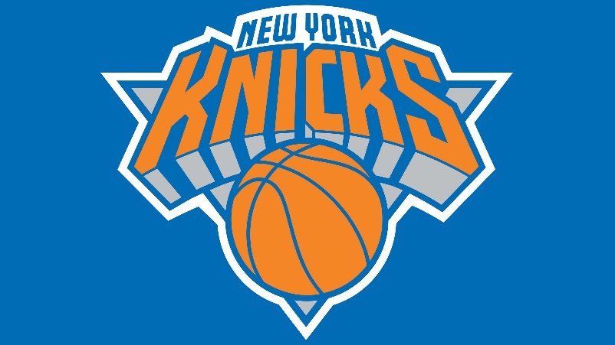
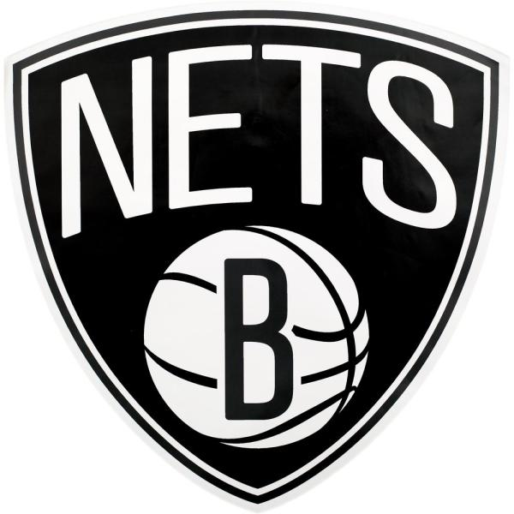
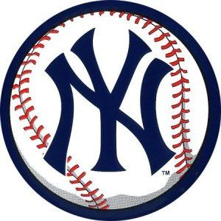
Opening of new sports bars in Manhattan-Bronx and Brooklyn
Manhattan-Bronx
Brooklyn
Demetris Englezos

Slide 2
Background/Problem
The ‘Sports Bar’ chain wants to open a two new bars to serve fans who don’t go to stadium because of covid-19
First in Manhattan-Bronx to serve Knicks and Yankees fans.
Second in Brooklyn for Nets fans
They already own a successful bar in a location in Queens.
We have to find the best two location for the new bars by taking useful data from the existing bar
Predict the occupancy of the bars depending the schedule of the teams.

Slide 3
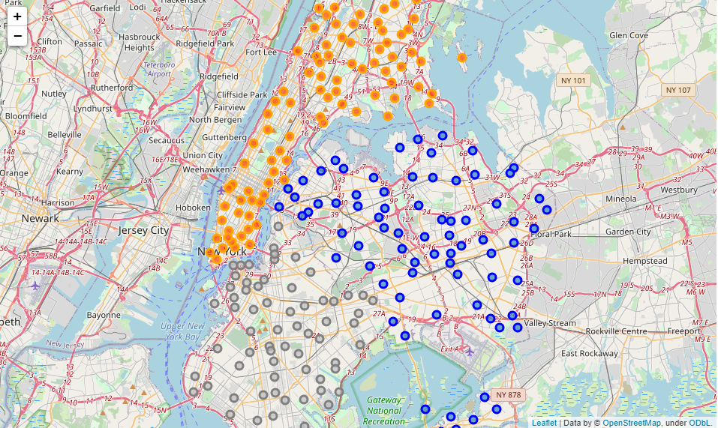
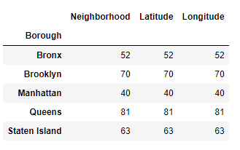
Data acquisition
Data from neighborhoods in New York collected.
Data for venues/bars in New York from Foursquare.
Data for the schedule from www.basketball-reference.com
Neighborhoods of New York in the background

Slide 4
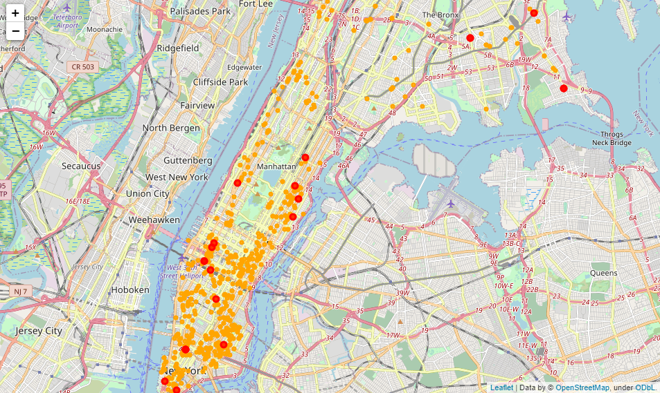
Data analysis Manhattan – Bronx Bars in the area of Manhattan-Bronx with orange and Sports Bars with red

Slide 5
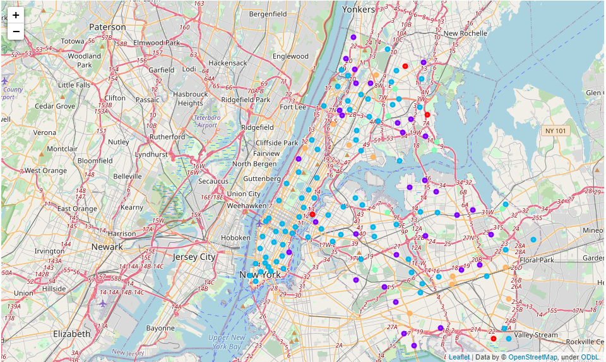
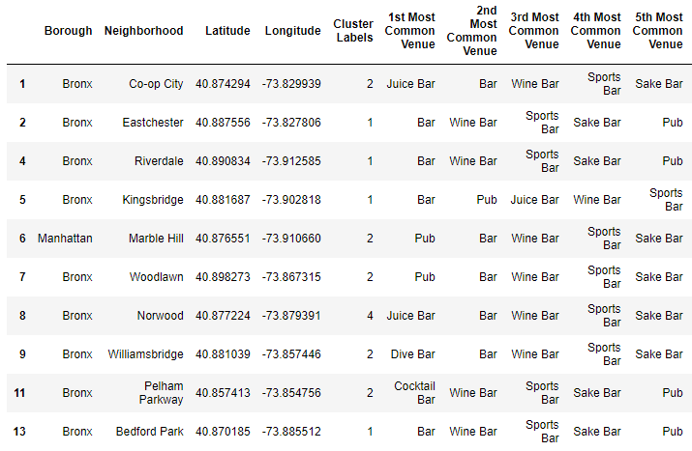
Clustering of the Neighborhoods

Slide 6
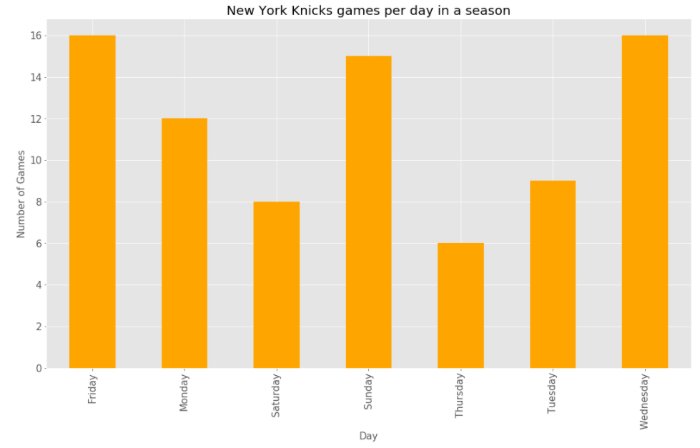
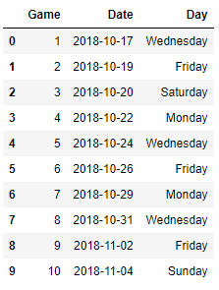
New York Knicks schedule – Bar occupancy

Slide 7
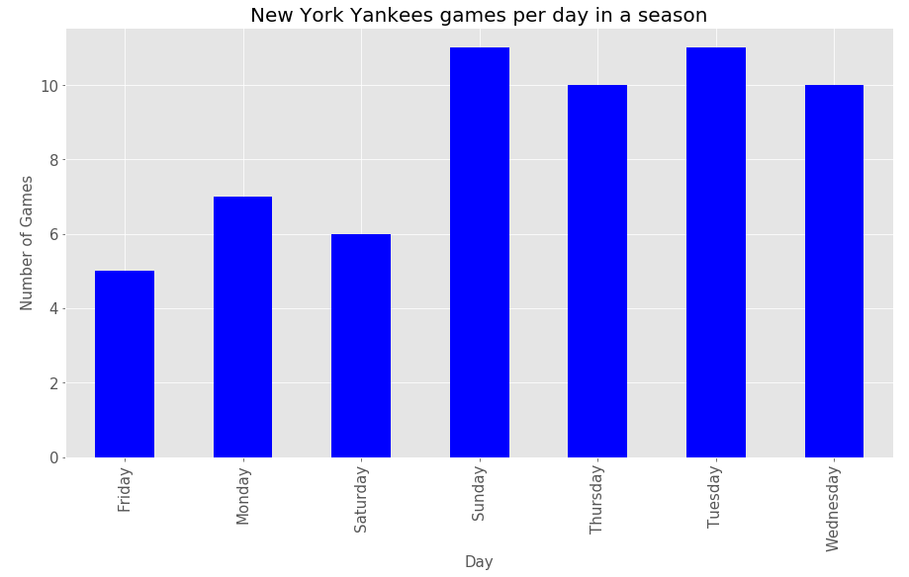
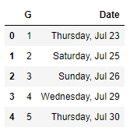
New York Yankees schedule – Bar occupancy

Slide 8
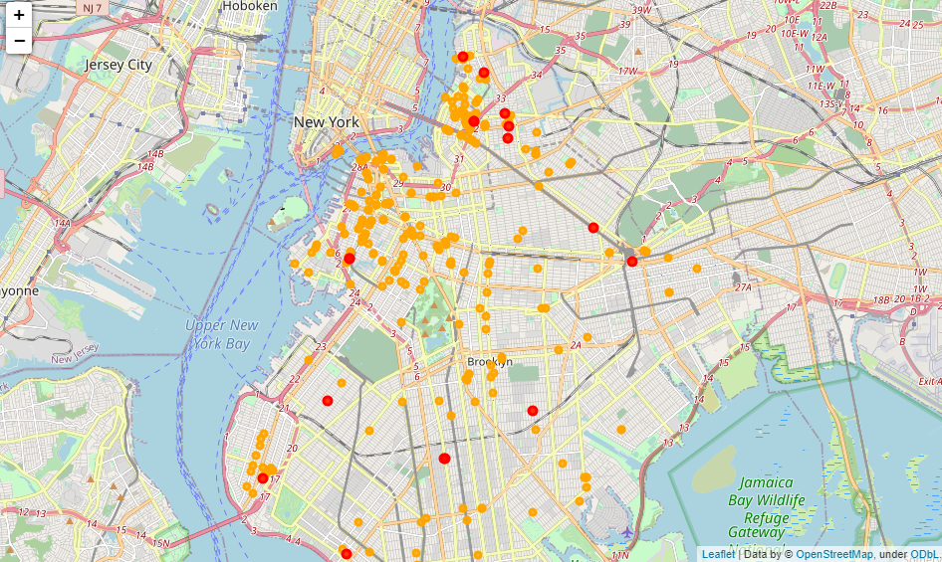
Data analysis Brooklyn Bars in the area of Manhattan-Bronx with orange and Sports Bars with red

Slide 9
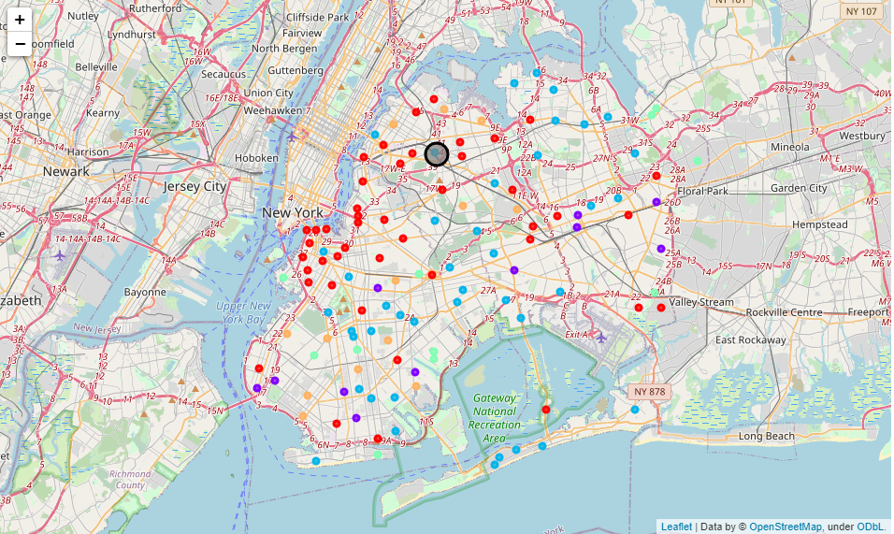
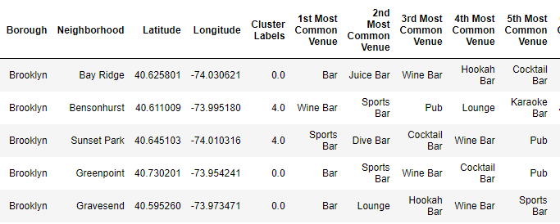
Clustering of the Neighborhoods

Slide 10
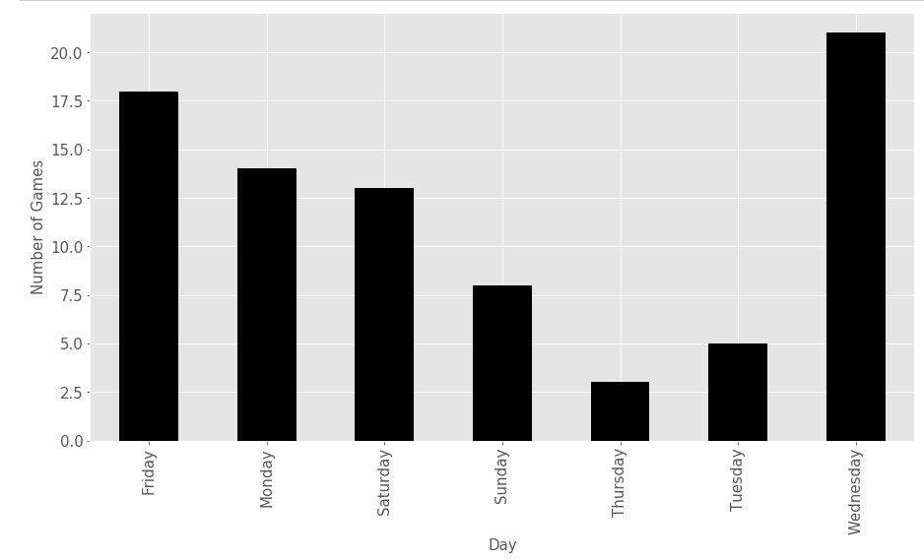
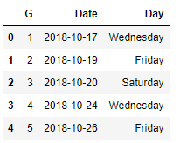
Brooklyn Nets schedule – Bar occupancy

Slide 11
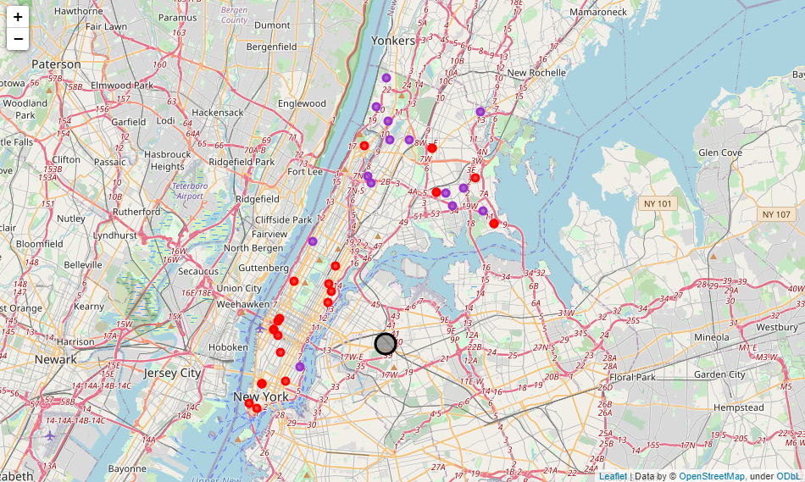
Results Manhattan-Bronx Bar Location
We can see that in purple are locations suitable for opening a new bar since the neighborhood is similar with the one in Queens. Also, we want to avoid sports bars close (red markers) so from a first view the purple neighborhood next to the river is a good location. Manhattan area is more suitable for the new bar since is more crowded with more venues. In addition, Manhattan is more suitable because New York Knicks are playing more games in a season than Yankees. They play for 7 months compare to 3 for Yankees. If further studies show that Yankees fans are fulling the bars more than Knicks then a location closer to Queens can be chosen like purple markers northern.

Slide 12
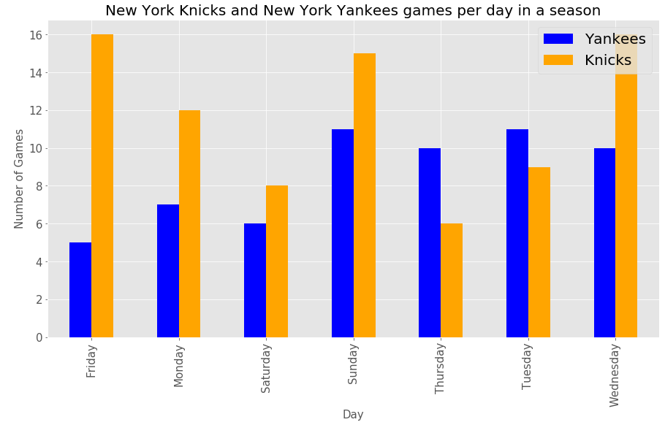
Results Manhattan-Bronx Bar Occupancy
From the above plot, we can say that except the expected days Saturday and Sunday, we expect New York Knicks fans on Wednesday and Friday so is good to have some extra staff these days (less day offs these days). Also maybe Thursdays are not busy

Slide 13
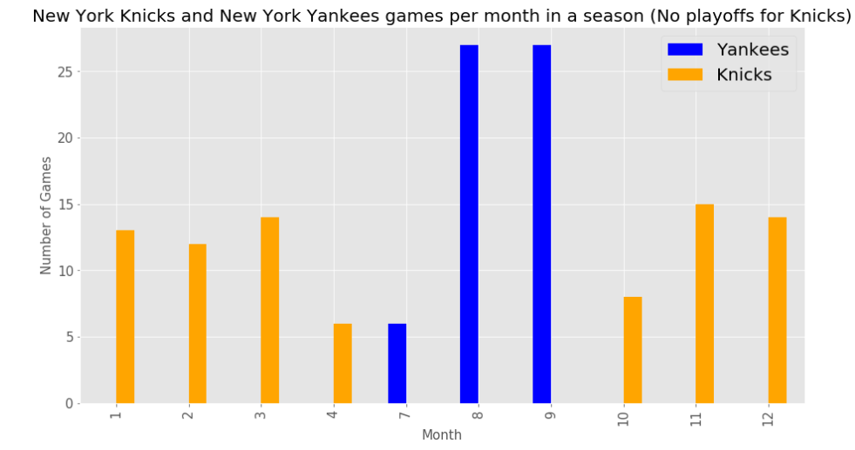
Results Manhattan-Bronx Bar Occupancy
As mentioned above, since Yankes are playing only for 3 months in a year, and Knicks for 7-8 (depend-ing if they enter playoffs) is better if the new bar is in Manhattan instead of Queens

Slide 14
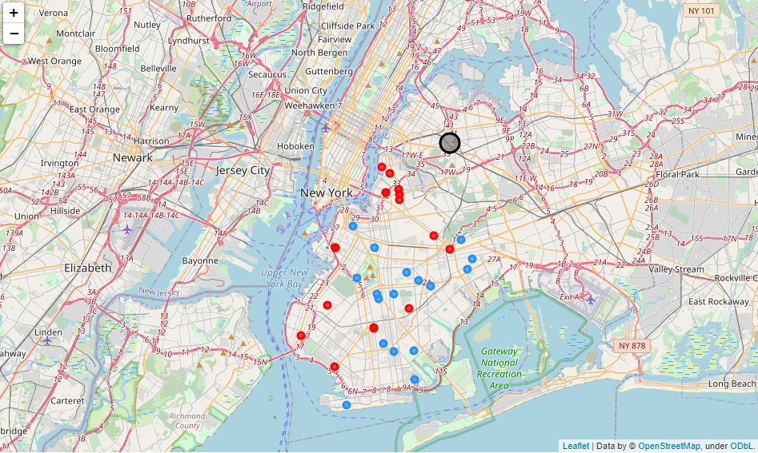
Results Brooklyn Bar Location
A potentially good location for the Bar in Brooklyn are the Neighborhoods with Blue in the center of Brooklyn because there is no sports bar close and are similar with the one in Queens.

Slide 15
Results Brooklyn Bar Occupancy
We can say that definitely we expect fans in Wednesdays and Fridays so is good to overstaff the bar these days alongside the weekend.

Slide 16
Conclusion and future analysis
In this study we analyze the best locations for an opening a new venue (Sport Bar in this case) after knowing a successful first location of the same venue. The results are quite interesting and the given notebook can also be used for similar cases except of Sports Bars.
In advance someone can collect more data for these locations and proceed with further analysis of the neighborhoods to cluster them with higher groups/clusters.
In addition, in this analysis we predict the busy days of the venue by knowing what kind of people we expect to crowd the venue.

